Slide 1



DESIGN ISSUES WITH / VLC media player
Jisha, Sarzila Sahrin
20-42526-1
HCI, section: [B]
Dept. of CSE
American Internation University – Bangladesh

Slide 2

Table of Contents
Affordance
Visibility
Mapping
System Image
Gulf of Execution
Gulf of Evaluation

Slide 3
AFFORDANCE
AFFORDANCE

Slide 4
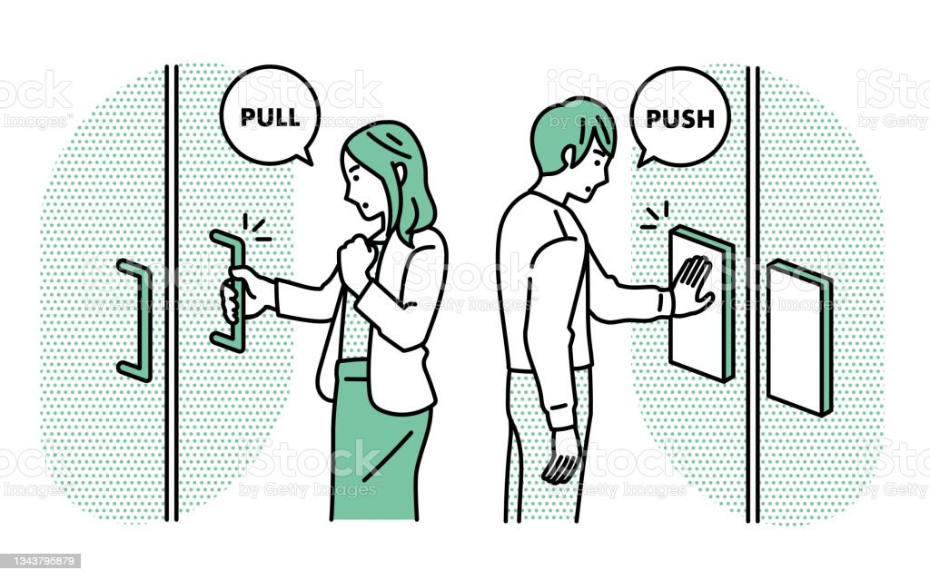
Affordance is the perceived and actual properties of a thing. Affordance is a relationship between the properties of an object and the capabilities of the agent that determine just how the object could possibly be used. Affordances exist even if they aren't visible.

Slide 5
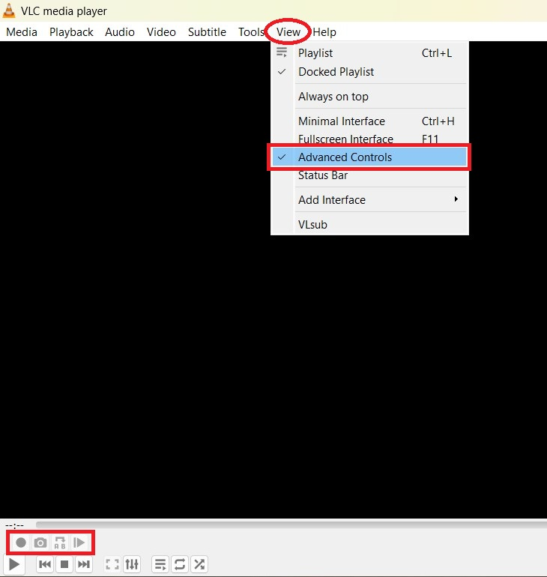
Affordance Issue with VLC media player
VLC appears to be a simple media player, where it has several features that aren't immediately apparent to new users. Many of us don’t know that we can record or stream video using the VLC media player. The ability to record a video or audio stream is not easily discoverable. But the lack of visual cues or affordances can be a challenge for users to locate and use these features.

Slide 6
VISIBILITY
AFFORDANCE

Slide 7

Visibility refers to how well a system's behavior is perceivable and understandable to users and what is the purpose of the specific system. Having a clear view of the system makes it easy for users, to transform their goals into actions.

Slide 8
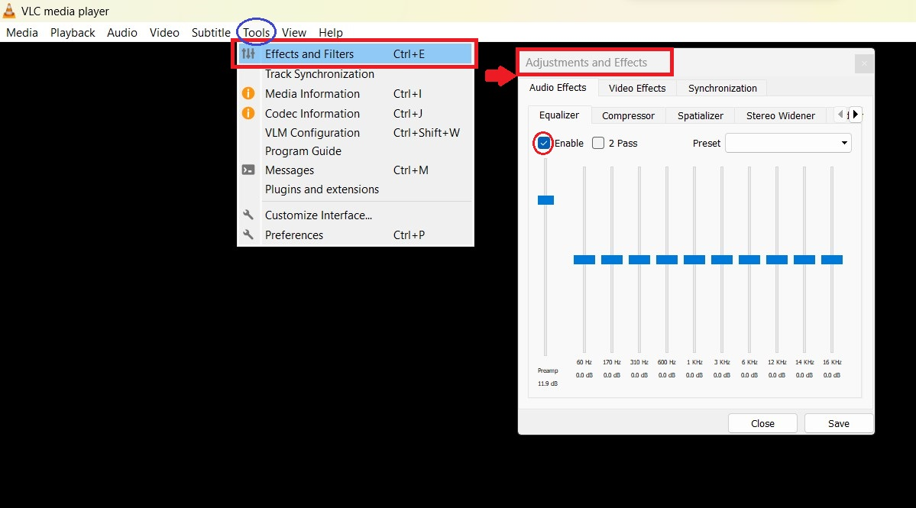
Visibility Issue with VLC media player
Here, how to enable the audio equalizer is displayed. An audio equalizer is for adjusting the volume of different frequency bands within an audio signal and it gives the audio that crunchy sound of music to our ears. But most of the users hardly use this feature. This feature is hard to discover and the user
user needs to go through several menus to find them. Even, some are unaware of this.

Slide 9
MAPPING
AFFORDANCE

Slide 10

Mapping is the relationship between controls and their affects. When mapping uses spatial correspondence between the layout of the controls and the devices being controlled, it is easy to determine how to use them. Human beings want the mapping to be ‘natural’. A good mapping contains good feedback.

Slide 11
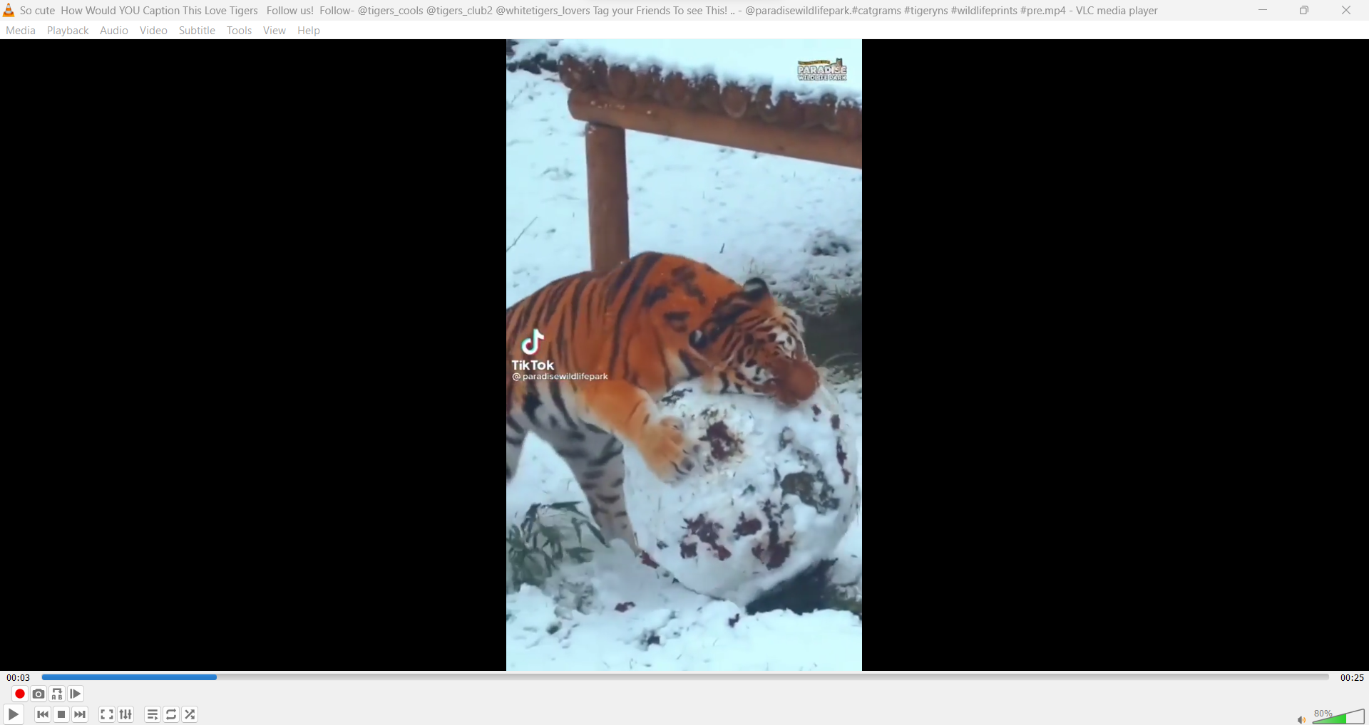
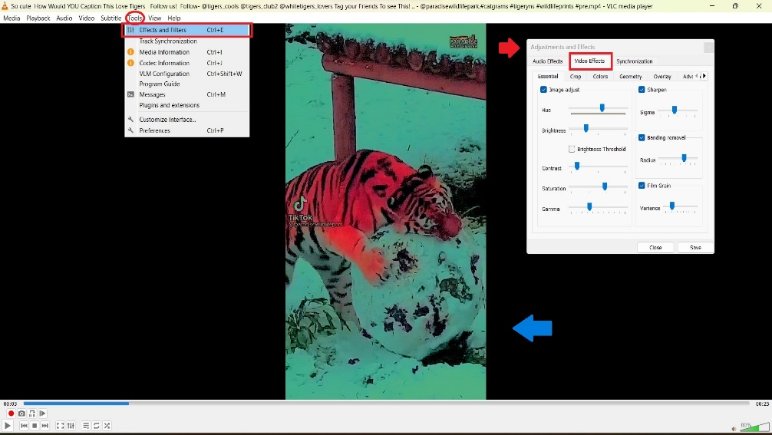
Mapping Issue with VLC media player
Keeping the video scene natural is more acceptable to humans. Here, the video effects menu has many buttons that allow users to adjust brightness, contrast, saturation, and so on. But these controls don’t have a clear relationship to their effect. This leads to making it challenging for users to understand what will happen when they use a particular control from the video effect buttons and it will be difficult to achieve their desired results.

Slide 12
SYSTEM IMAGE
AFFORDANCE

Slide 13

System-Image is the visible part of a device. The designer only talks to the user through the system image. System image refers to the user's mental model, which is the conceptual model of the way something works. If the system image doesn't make the design model clear, then the user will create a different model through their interaction.

Slide 14
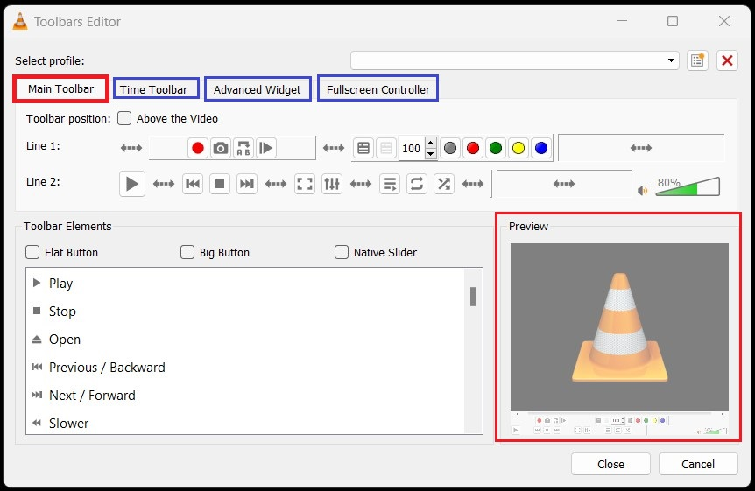
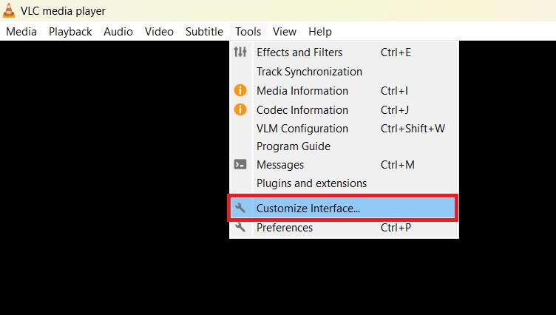

System Image Issue with VLC media player

Slide 15
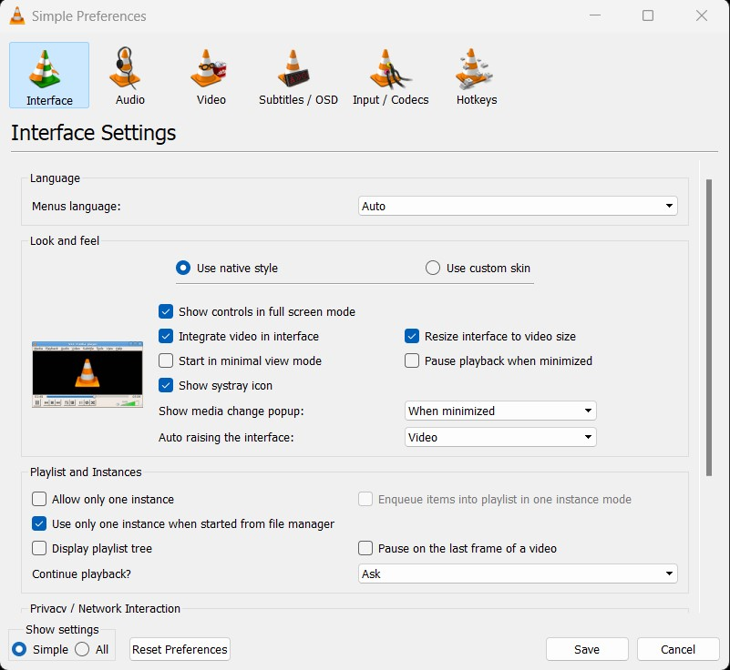
System Image Issue with VLC media player
The possible level of customization for the system image is limited. While it has a robust set of features, the interface is not as eye-catching as some of its competitors. Besides, functions are easily accessible through menus, buttons, or keyboard shortcuts, but the user is unaware of it. That leads to making the software appear outdated, which may discourage many users from using or trying this software.
Humans create their own mental models. That’s why, it is saying that good conceptual models are the key to understandable, enjoyable products: good communication is the key to good conceptual models.

Slide 16
GULF OF EXECUTION
&
GULF OF EVALUATION
AFFORDANCE

Slide 17
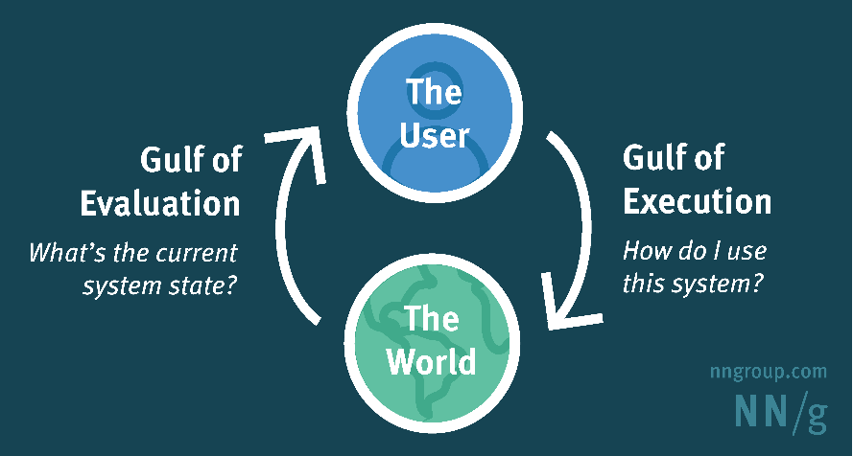
When people use something, they face two gulfs; the Gulfs of Execution, where they try to figure out how it operates, and the Gulf of Evaluation, where they try to figure out what happened.
Gulf of Execution is the gap of execution between the mental model and affordance. It refers to how well the system allows someone to do their intended actions directly.
Gulf of Evaluation refers to how well the system provides a visible state of the user's intentions and expectations, that is immediately observable and interpretable.

Slide 18
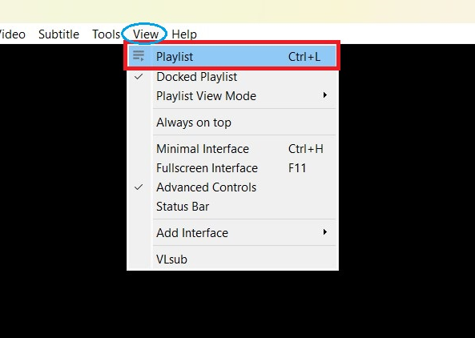
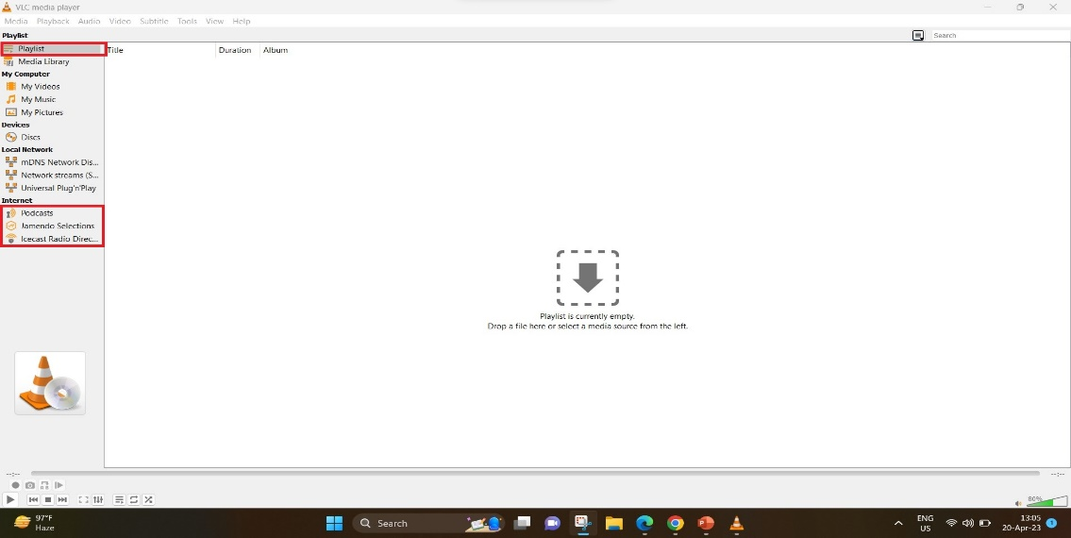

Gulf of Execution Issue with VLC media player
Here, the issue is the complexity of this software's interface. One of them is the playlist feature is not immediately visible in VLC media player, when the software is launched. The playlist provides a wide range of options for creating and managing playlists, but these options are difficult to navigate or use and hard to remember. That leads users to be confused or frustrated.

Slide 19
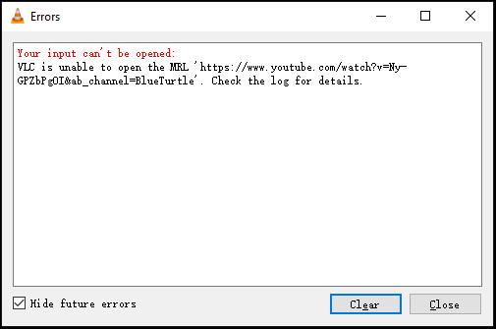
Gulf of Evaluation Issue with VLC media player
Sometimes, VLC media player failed to open files or read input and other errors. But the lack of giving clear error messages or feedback arise Gulf of Evaluation. And users may struggle to understand why the software is not working correctly or how to fix the issue without more clear and concise feedback.

Slide 20

THANK YOU

